Slide 1
Geothermal Energy Technology And Current Status:
An Overview
Presenter’s Name
Affiliation / Organization
presenter@email.com

Slide 2
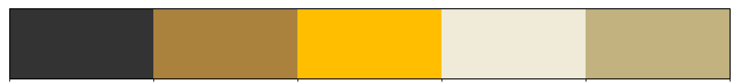
Geothermal Field
Geothermal fields, as opposed to hydrocarbon fields, are generally systems with a continuous circulation of heat and fluid, where fluid enters the reservoir from the recharge zones and leaves through discharge areas (hot springs, wells). During industrial exploitation, fluids are recharged to the reservoir by reinjecting the waste fluids from the utilization plants through wells. This reinjection process may compensate for at least part of the fluid extracted by the production and will to a certain extent prolong the commercial lifetime of the field. Geothermal energy is therefore to some extent a renewable energy source; however, the hot fluid production rates tend to be much larger than the recharge rates

Slide 3
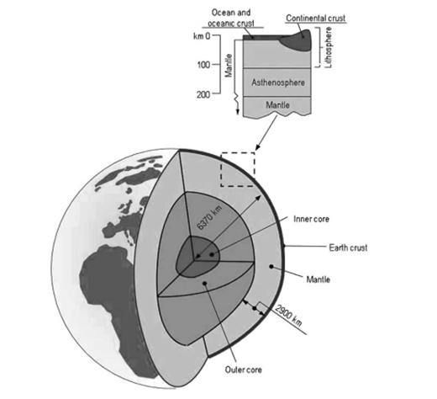
Geothermal Field
Geothermal fields, as opposed to hydrocarbon fields, are generally systems with a continuous circulation of heat and fluid, where fluid enters the reservoir from the recharge zones and leaves through discharge areas (hot springs, wells). During industrial exploitation, fluids are recharged to the reservoir by reinjecting the waste fluids from the utilization plants through wells.

Slide 4
References
Anderson, A., & Rezaie, B. (2019). Geothermal technology: Trends and potential role in a sustainable future. Applied Energy, 248, 18–34. https://doi.org/10.1016/j.apenergy.2019.04.102
Beckers, K. F., Rangel-Jurado, N., Chandrasekar, H., Hawkins, A. J., Fulton, P. M., & Tester, J. W. (2022). Techno-Economic Performance of Closed-Loop Geothermal Systems for Heat Production and Electricity Generation. Geothermics, 100, 102318. https://doi.org/10.1016/j.geothermics.2021.102318
Breede, K., Dzebisashvili, K., Liu, X., & Falcone, G. (2013). A systematic review of enhanced (or engineered) geothermal systems: Past, present and future. Geothermal Energy, 1(1), 4. https://doi.org/10.1186/2195-9706-1-4

Slide 5
Thank you

